Slide 1
AZ-304: Microsoft Azure Architect Design

Slide 2
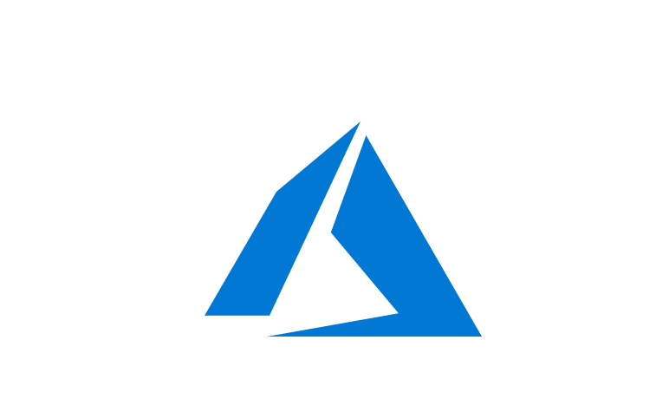
Course Outline
Module 1: Design a Compute Solution
Module 2: Design a Network Solution
Module 3: Design for Migration
Module 4: Design Authentication and Authorization
Module 5: Design Governance
Module 6: Design a Solution for Databases
Module 7: Select an Appropriate Storage Account
Module 8: Design Data Integration
Module 9: Design a Solution for Logging and Monitoring
Module 10: Design a Solution for Backup and Recovery
Module 11: Design for High Availability
Module 12: Design for Cost Optimization
Module 13: Design an Application Architecture
Module 14: Design Security for Applications
NOTE: The module order listed above aligns with the learning objectives described on the AZ-304: Microsoft Azure Architect Design certification page.

Slide 3
Module 14: Design Security for Applications
Solutions using Key Vault and Azure AD Managed Identities

Slide 4
Learning Objectives
Security for Applications and Services
Recommend a Solution using Key Vault
Recommend Solutions using Azure AD Managed Identities
Module Review Questions

Slide 5

Security for Applications and Services
Notes:
Well-architected Framework – Security

Slide 6
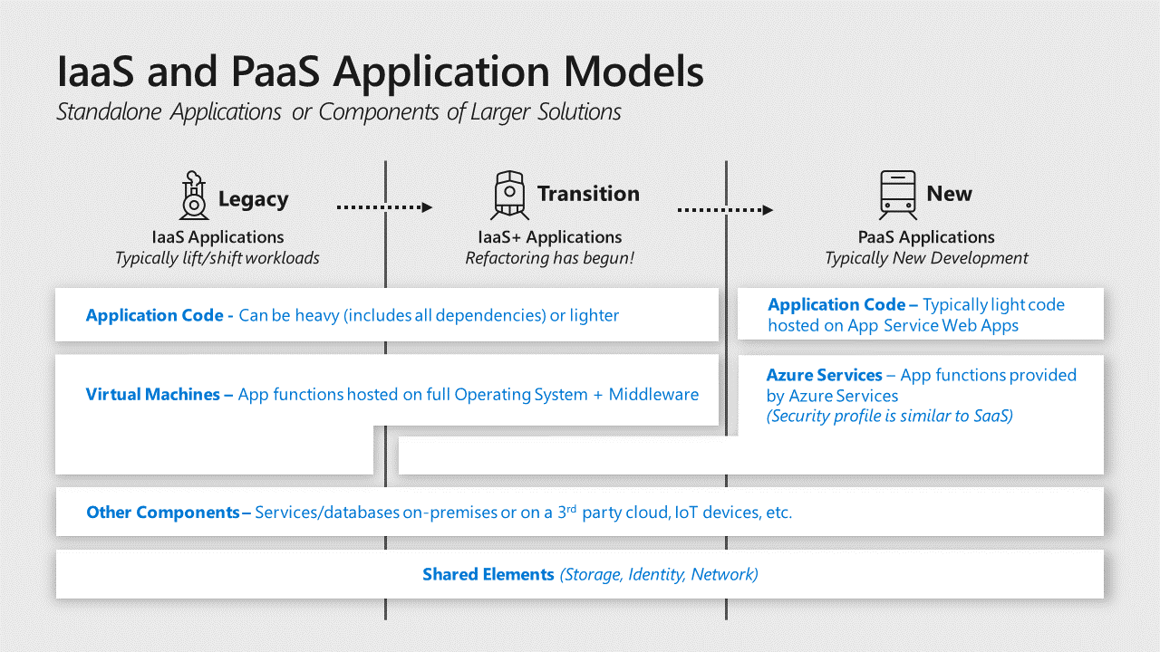
Security for Applications and Services
Legacy
Modern
Hybrid
Notes:
Legacy
applications are hosted on Infrastructure as a Service (IaaS) virtual machines that typically include all dependencies including OS, middleware, and other components.
Modern
Platform as a Service (PaaS) applications don’t require the application owner to manage and secure the underlying server operating systems (OSes) and are sometimes fully “Serverless” and built primarily using functions as a service.
Hybrid
While hybrid applications can take many forms, the most common is an “IaaS plus” state where legacy applications are transitioning to a modern architecture with modern services replacing legacy components or being added a legacy application.
https://docs.microsoft.com/en-us/azure/architecture/framework/security/applications-services

Slide 7

Identify and Classify Business Critical Applications
Business critical data
Regulated data - payment card industry (PCI) and Health Information Portability and Accountability Act (HIPAA)
Business critical availability
Significant Access - Stored Credentials or keys/certificates
Notes:
Business critical data – Applications that process or store information, which would cause significant negative business or mission impact if an assurance of confidentiality, integrity, or availability is lost.
Regulated data – Applications that handle monetary instruments and sensitive personal information regulated by standards.
Business critical availability – Applications whose functionality is critical to organizations business mission such as production lines generating revenue, devices, or services critical to life and safety, and other critical functions.
Significant Access – Applications which have access to systems with a high potential impact through technical means such Stored Credentials and Permissions.

Slide 8

Adopt the DevOps Approach
Waterfall vs CI/CD
Organizations should shift from a ‘Waterfall’ development cycle to DevOps lifecycle of continuous integration, continuous delivery (CI/CD) for applications as fast as is practical
The DevOps model increases an organization’s ability to rapidly address security concerns without waiting for a longer planning and testing cycle of a waterfall model

Slide 9

Use Cloud Services Instead of Custom Implementations
Identity – Avoid using homegrown authentication solutions and favor mature capabilities
Data Protection – Use cloud providers native encryption in cloud services to encrypt and protect data
Key management – Leverage key management services to manage and secure keys rather than attempting to safely handle keys in application code
Application Configurations – Azure App Configuration provides a service to centrally manage application settings and feature flags, which helps mitigate this risk
Notes:
Identity – Avoid using homegrown authentication solutions and favor mature capabilities like Azure Active Directory (Azure AD), Azure AD B2B, Azure AD B2C, or third-party solutions to authenticate and grant permission.
Data Protection – Developers should use cloud providers such as native encryption in cloud services to encrypt and protect data. Use well-established cryptographic algorithms and do not attempt to invent your own.
Key management – Leverage a key management service like Azure Key Vault or AWS Key Management Service to manage and secure these keys rather than attempting to safely handle keys in application code.
✔️ Note: CredScan discovers potentially exposed keys in application code.
Application Configurations – Azure App Configuration provides a service to centrally manage application settings and feature flags, which helps mitigate this risk.

Slide 10

Preference for Identity Authentication Instead of Keys
Authenticate with identity services rather than cryptographic keys when available
Managing keys securely with application code is difficult and leads to mistakes like accidentally publishing sensitive access keys
For services that offer the Azure AD authentication like Azure Storage, Azure App Service, Azure Backup, use authentication and authorization

Slide 11
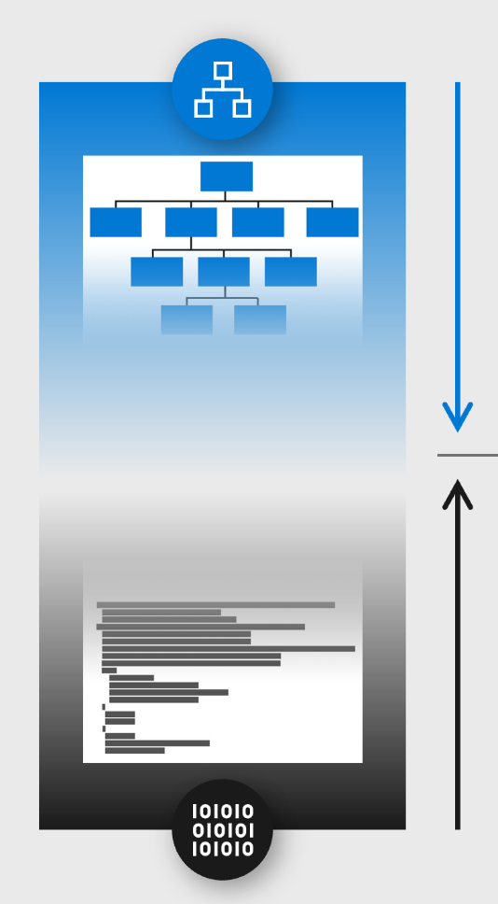
Bottom-Up Approach to Reduce Security Bug Volume and Impact
Applications have logic errors resulting in security risk to discover, evaluate, and bugs avoid damage to an organization’s reputation
Mitigating application risk is achieved by integrating security practices and tools into the development lifecycle (SDL or SDLC)

Slide 12
Top-down Approach Through Threat Modeling
Prioritize by risk
Progressively evaluate application design
System level design
Application level
Component level
Align with Development lifecycle
Waterfall
DevOps
Legacy applications
Notes:
Prioritize by risk - Apply threat modeling first to business-critical applications that would have an outsized impact on the business if compromised.
Progressively evaluate application design – Start with the architecture level design and progressively increase detail:
System level design – includes applications and how they interact with each other
Application level – includes components of the application and how they interact with each other
Component level – includes how the individual component is composed and how each element of it interacts with each other
Align with Development lifecycle – Optimize efforts by aligning threat modeling activities with application development lifecycles.
Waterfall
DevOps
Legacy applications

Slide 13
Recommend a Solution using Key Vault

Slide 14
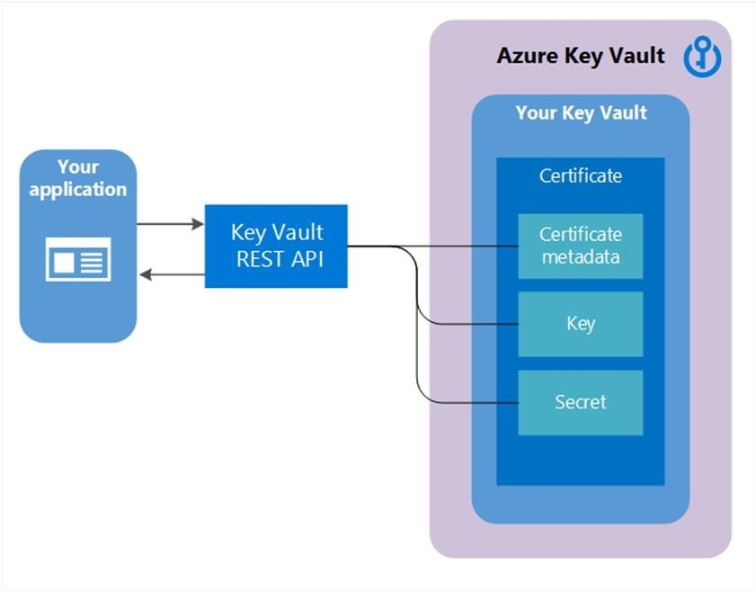
Azure Key Vault Overview
Vaults reduce accidental loss of security information by centralizing application secrets storage
Keys in a key vault are a cryptographic assets
Two variations of keys in Key Vault:
Hardware-protected, and software-protected
Secrets are small data blobs protected by an HSM-generated key created with the Key Vault
Notes:
Key vaults control and log the access to anything stored in them.
Vaults reduce accidental loss of security information by centralizing application secrets storage.
Keys in a key vault are a cryptographic assets for a particular use such as the asymmetric master key of Microsoft Azure RMS, or the asymmetric keys used for SQL Server TDE, CLE, and Encrypted backup.
Two variations of keys in Key Vault: hardware-protected, and software-protected.
Secrets are small data blobs protected by a HSM-generated key created with the Key Vault.

Slide 15

Key Vault Authentication and Authorization
Authentication: Azure Active Directory to authenticate users and applications
Authorization: Role-based access control (RBAC)
Reading and writing data in the Key Vault uses a separate Key Vault access policy
Restrict network access: Services in the network can access the vault
Notes:
Authentication: Azure Key Vault uses Azure Active Directory to authenticate users and applications. Authentication is performed by associating the Azure AD tenant of the subscription that the Key Vault is part of.
The app making a request must be known to AAD.
Authorization: Management operations (creating a new Azure Key Vault) use role-based access control (RBAC). Built-in role Key Vault Contributor provides access to management features of key vaults but doesn't allow access to the key vault data.
Reading and writing data in the Key Vault uses a separate Key Vault access policy. A Key Vault access policy is a permission set assigned to a user or managed identity to read, write, and/or delete secrets and keys.
Restrict network access: Services in the network can access the vault. Determine the minimum network access required
For example: Restrict Key Vault endpoints to specific Azure Virtual Network subnets, specific IP addresses, or trusted Microsoft services.

Slide 16

Azure Key Vault Availability and Redundancy
Key Vault features multiple layers of redundancy
Contents of key vault are replicated within the region and to a secondary region at least 150 miles away
If components within the key vault service fail, alternate components within the region step in
Notes:
Key Vault features multiple layers of redundancy to make sure that your keys and secrets remain available to apps if components of the service fail.
Contents of key vault are replicated within the region and to a secondary region at least 150 miles away but within the same geography.
If components within the key vault service fail, alternate components within the region step in to make sure that there’s no degradation of functionality.

Slide 17
Recommend Solutions using Azure AD Managed Identities

Slide 18

Azure Active Directory Managed Identities
Use managed identities to authenticate to any service that supports Azure AD authentication
Client ID – unique identifier
Principal ID – the object ID
Azure Instance Metadata Service (IMDS) – accessible to all IaaS VMs created via the Azure Resource Manager
(169.254.169.254)
Notes:
Client ID - a unique identifier generated by Azure AD that is tied to an application and service principal during its initial provisioning.
Principal ID - the object ID of the service principal object for your managed identity that is used to grant role-based access to an Azure resource.
Azure Instance Metadata Service (IMDS) - a REST endpoint accessible to all IaaS VMs created via the Azure Resource Manager.

Slide 19
How Managed Identities for Azure Resources Works
A system-assigned managed identity is enabled directly on an Azure service instance
A user-assigned managed identity is created as a standalone Azure resource
Notes:
Two types of managed identities:
A system-assigned managed identity is enabled directly on an Azure service instance.
When the identity is enabled, Azure creates an identity for the instance in the Azure AD tenant that's trusted by the subscription of the instance.
After the identity is created, the credentials are provisioned onto the instance.
If the instance is deleted, Azure automatically cleans up the credentials and the identity in Azure AD.
A user-assigned managed identity is created as a standalone Azure resource.
Azure creates an identity in the Azure AD tenant that's trusted by the subscription in use.
After the identity is created, the identity can be assigned to one or more Azure service instances.
A system-assigned managed identity is enabled directly on an Azure service instance. When the identity is enabled, Azure creates an identity for the instance in the Azure AD tenant that's trusted by the subscription of the instance. After the identity is created, the credentials are provisioned onto the instance. The life cycle of a system-assigned identity is directly tied to the Azure service instance that it's enabled on. If the instance is deleted, Azure automatically cleans up the credentials and the identity in Azure AD.
A user-assigned managed identity is created as a standalone Azure resource. Through a create process, Azure creates an identity in the Azure AD tenant that's trusted by the subscription in use. After the identity is created, the identity can be assigned to one or more Azure service instances. The life cycle of a user-assigned identity is managed separately from the life cycle of the Azure service instances to which it's assigned.

Slide 20
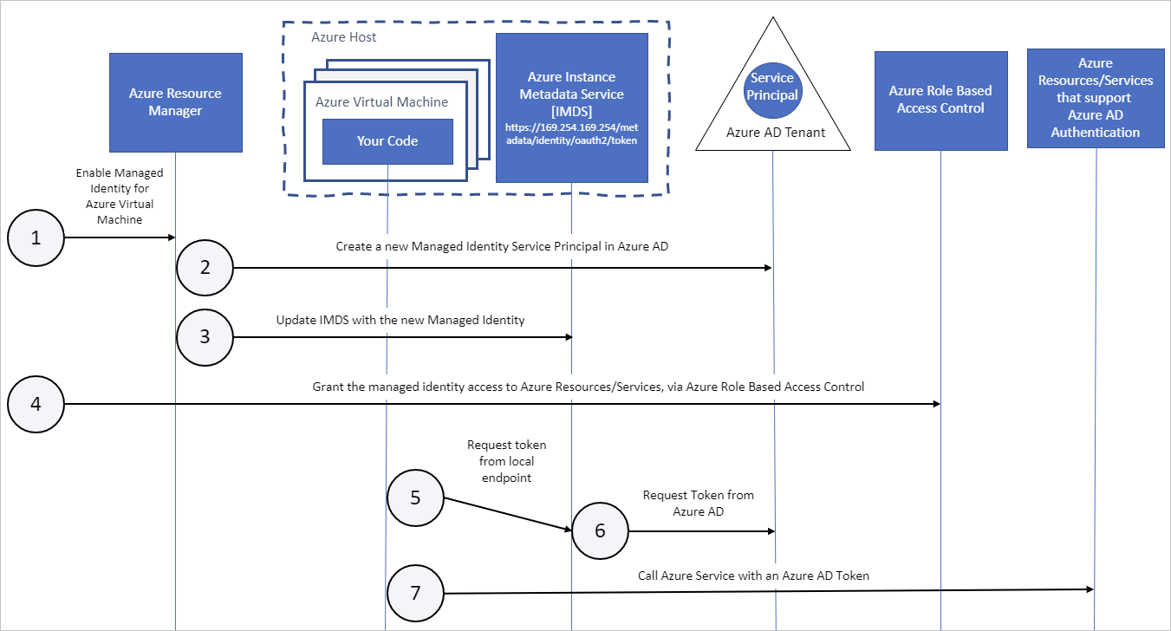
System-Assigned Managed Identity and Azure VMs
Notes:
Azure Resource Manager receives a request to enable the system-assigned managed identity on a VM.
Azure Resource Manager creates a service principal in Azure AD for the identity of the VM. The service principal is created in the Azure AD tenant that's trusted by the subscription.
Azure Resource Manager configures the identity on the VM by updating the Azure Instance Metadata Service identity endpoint with the service principal client ID and certificate.
After the VM has an identity, use the service principal information to grant the VM access to Azure resources. To call Azure Resource Manager, use role-based access control (RBAC) in Azure AD to assign the appropriate role to the VM service principal. To call Key Vault, grant your code access to the specific secret or key in Key Vault.
Your code that's running on the VM can request a token from the Azure Instance Metadata service endpoint, accessible only from within the VM: http://169.254.169.254/metadata/identity/oauth2/token
The resource parameter specifies the service to which the token is sent. To authenticate to Azure Resource Manager, use resource=https://management.azure.com/.
API version parameter specifies the IMDS version, use api-version=2018-02-01 or greater.
A call is made to Azure AD to request an access token (as specified in step 5) by using the client ID and certificate configured in step 3. Azure AD returns a JSON Web Token (JWT) access token.
Your code sends the access token on a call to a service that supports Azure AD authentication.

Slide 21

Course Summary

Slide 22
Closing Agenda
Summary of Learning
Learning Resources
Exam Registration Demo
Learning Experience Survey

Slide 23
Summary of Learning
Module 1: Design a Compute Solution
Module 2: Design a Network Solution
Module 3: Design for Migration
Module 4: Design Authentication and Authorization
Module 5: Design Governance
Module 6: Design a Solution for Databases
Module 7: Select an Appropriate Storage Account
Module 8: Design Data Integration
Module 9: Design a Solution for Logging and Monitoring
Module 10: Design a Solution for Backup and Recovery
Module 11: Design for High Availability
Module 12: Design for Cost Optimization
Module 13: Design an Application Architecture
Module 14: Design Security for Applications
Notes:
Summary of Learning: leverage Mentimeter to capture learnings from the course experience. Discuss course expectations from beginning. Frame discussion around what we learned during the learning event meet. Discover if we met or exceeded our attendees’ expectations.

Slide 24
Learning Resources
Skillpipe
Hosted Lab Access
Learn (http://aka.ms/learn)
Microsoft Hands-on Labs (http://www.microsoft.com/handsonlabs)
Azure Learning Paths
Azure Friday videos
Notes:
Use this time to highlight additional learning resources: Skillpipe, Hosted Lab Access, MSLearn, Microsoft Hands-on Labs, Azure Skilling on Pluralsight
. Emphasis up to 180-day continued access for courses with hosted labs.
Note: If not a Job Role course (e.g. AZ-900) > Hosted Lab Access would not apply but point to free Hands on Labs.

Slide 25
Azure Learning Paths

Slide 26
Exam Registration
Notes:
Live Demo of exam registration process. Focus on using the voucher and remote lab proctoring if course. Leverage https://aka.ms/attap if event is proctored.

Slide 27
Learner Experience Portal
Schedule FREE Microsoft Certification Exams
Register for additional Microsoft Training
Access self-paced learning
http://esi.microsoft.com
Login with your WORK email
Notes:
Trainer talking points:
Now that you have completed your training you are eligible to take the Microsoft Azure Fundamentals certification exam at no cost. Here’s how to schedule your exam:
Navigate to esi.microsoft.com
Login with your work email address
Click the Microsoft Certification tile to begin the online registration process
Sign in or create a Certification Profile
Navigate to the exam discounts page and enter your WORK email address to check eligibility. You must link your account to receive discount.
The system will walk them through the steps necessary to register for their exam
For any issues with your exam redemption, please open a case the ESI Support Portal
I want to encourage you to continue your learning:
Be sure to check out esi.microsoft.com for more free education about Azure.
ATT Reference only:
External LxP and Exam Discount onboarding deck: https://microsoft.sharepoint.com/:p:/r/teams/TrainingProgramManager/_layouts/15/Doc.aspx?sourcedoc=%7B2106C79E-37FE-4EE9-92DE-5ACC070824E4%7D&file=LxP%20External%20Training.pptx&action=edit&mobileredirect=true
LxP sign in video – https://aka.ms/LxPWalkthroughVideo
Exam Discount video - https://aka.ms/LxPExamDiscountVideo

Slide 28
Learning Experience Survey
Notes:
Use this time to remind the audience that we value and appreciate prompt feedback. Allow time to complete the survey if available. Leverage a vanity URL.

Slide 29

Ευχαριστώ
Grazie
Thank you!
Kiitos
Спасибо
Gracias
Dzięki
唔該
感謝你
Teşekkürler
धन्यवाद
شكر
Merci
Takk
Danke
Obrigado
감사합니다
ありがとう
مرسي
Notes:
Thank the attendees, customer point-of-contact (PoC), and Microsoft PoC. Stage additional follow through on Parking lot items via Microsoft contacts.

